Slide 1
Initialization
NWP Model
Dynamics
Physics
Lateral Boundary Conditions
Raw Forecasts
Weather products

Slide 2
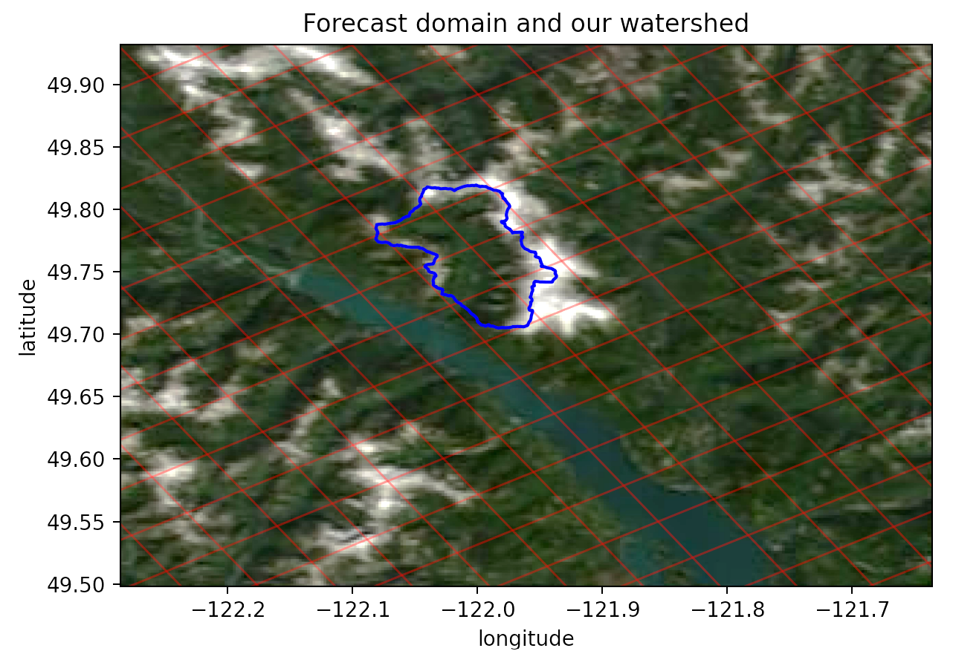
Values from forecast output that lie in the watershed

Slide 3
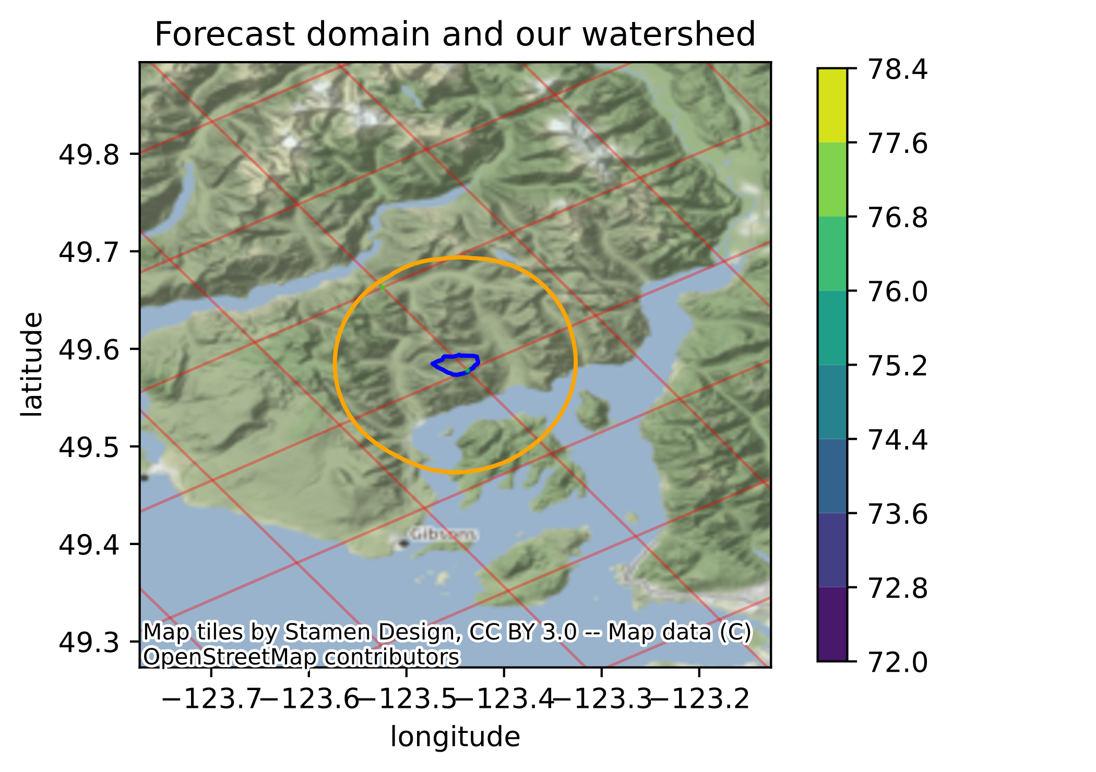
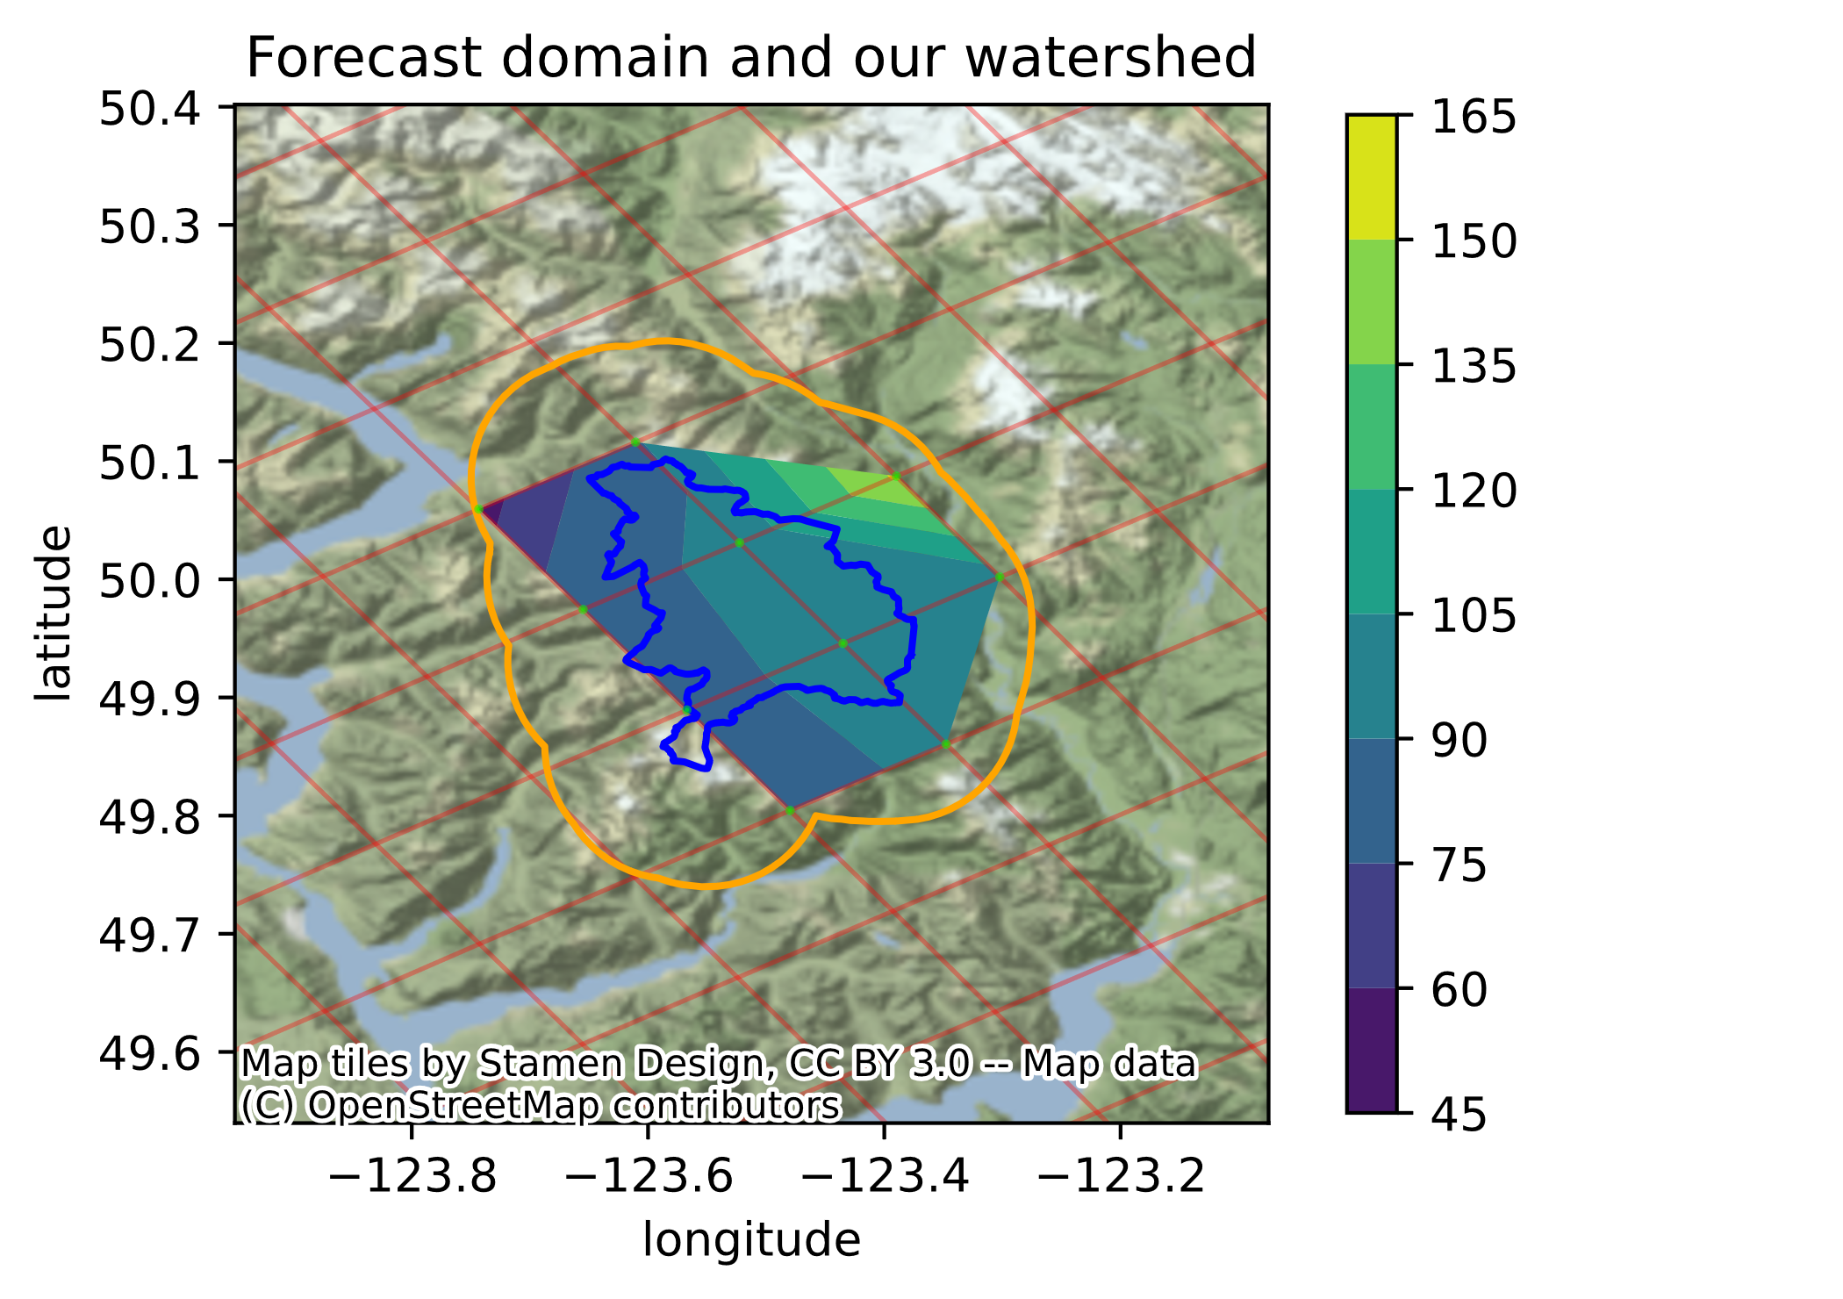
Box Canyon
Ashlu Creek

Slide 4
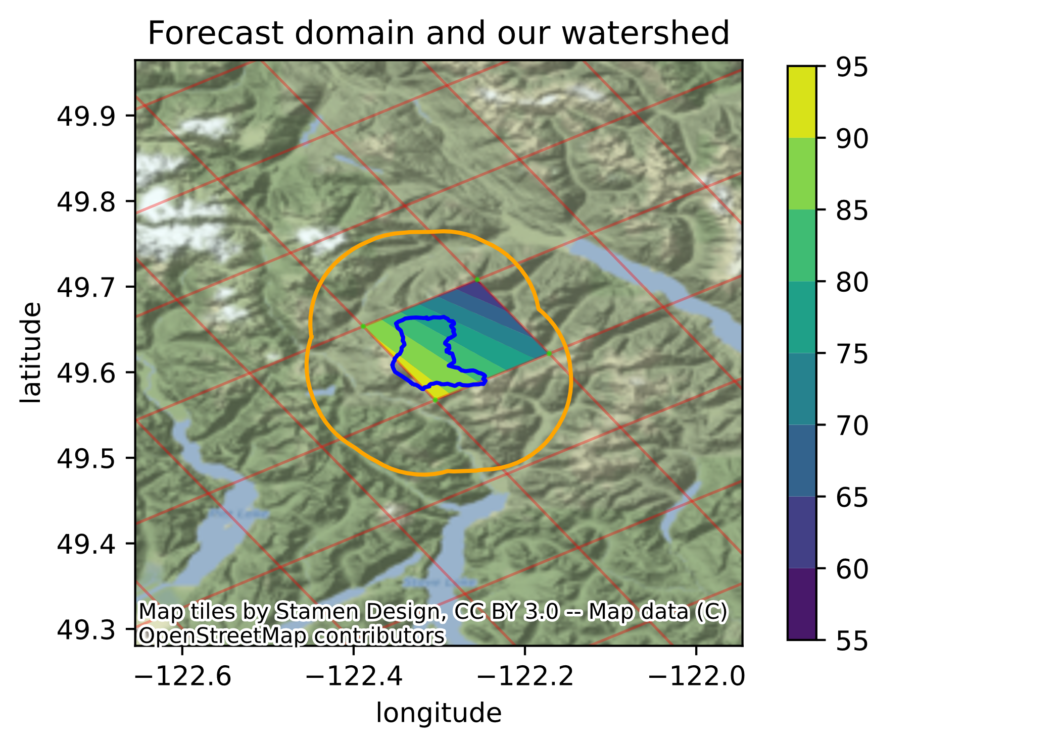
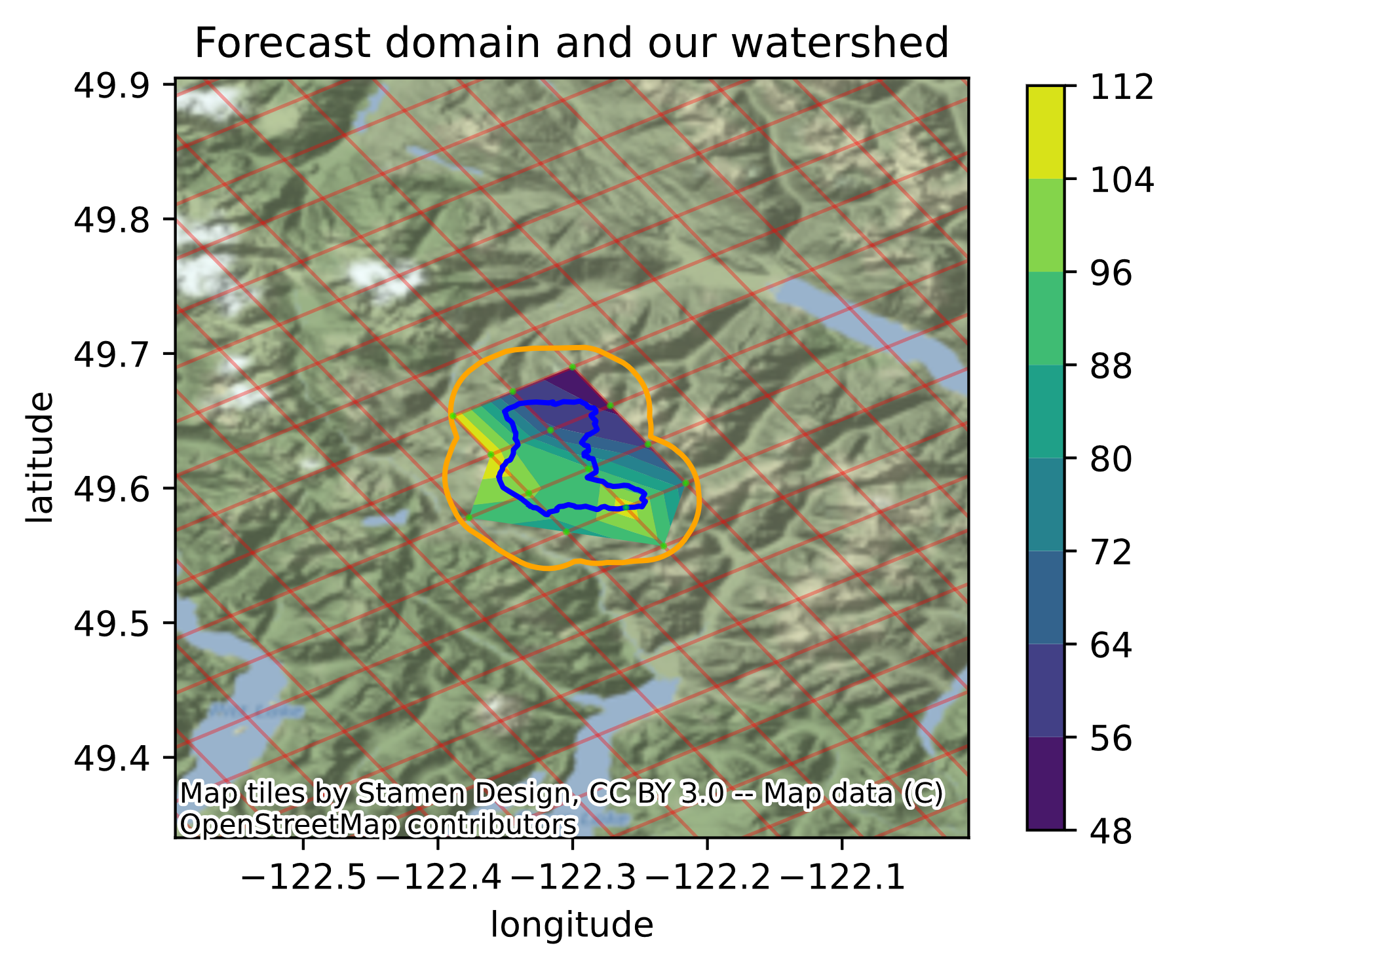
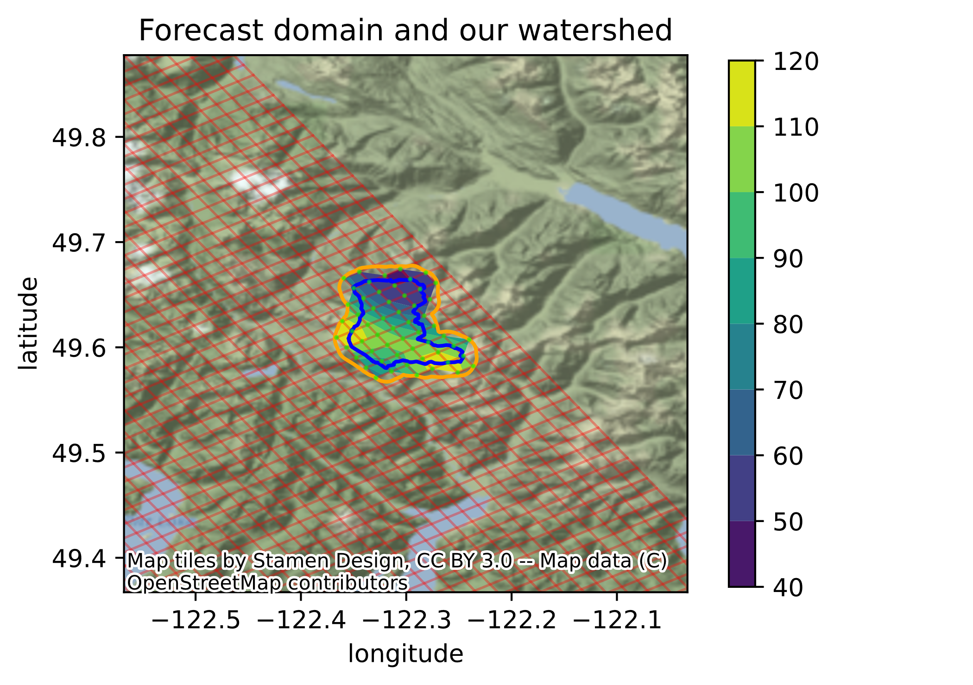

Slide 5
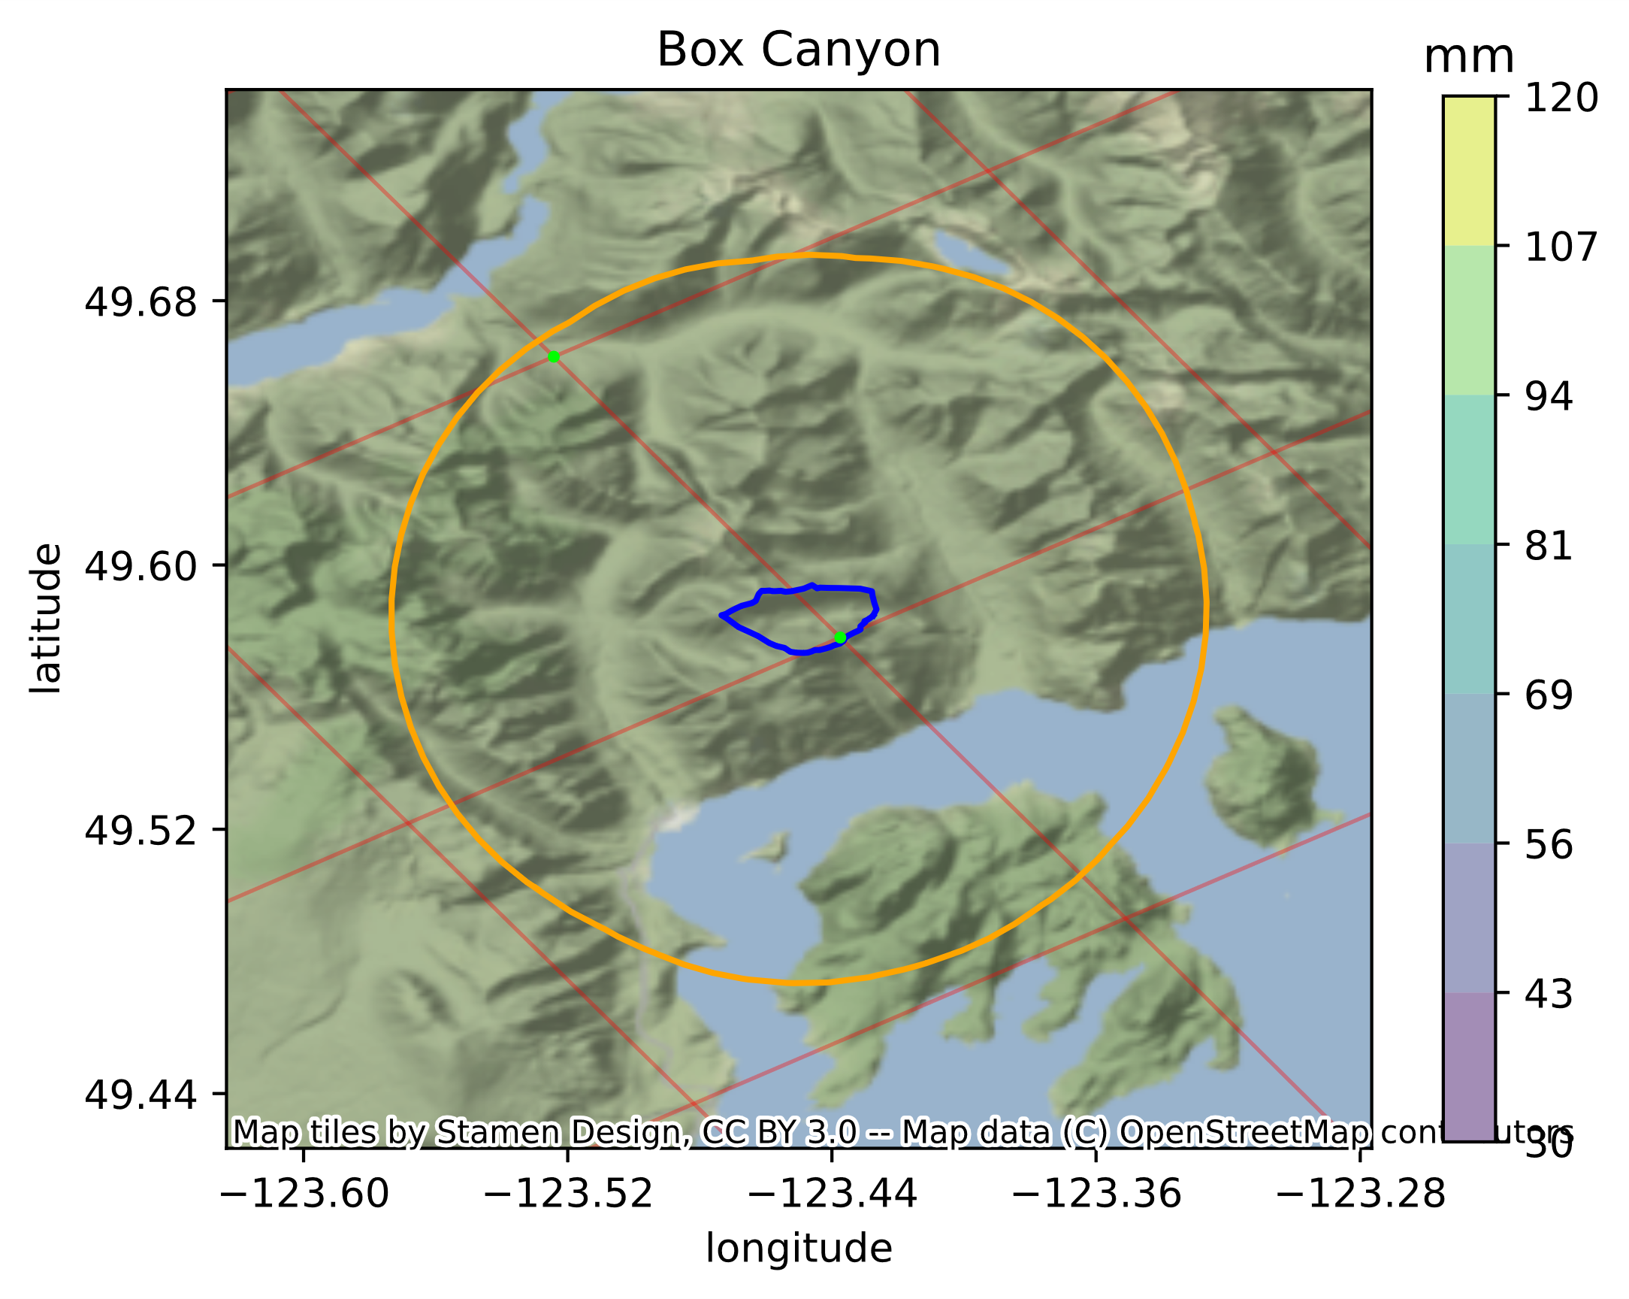
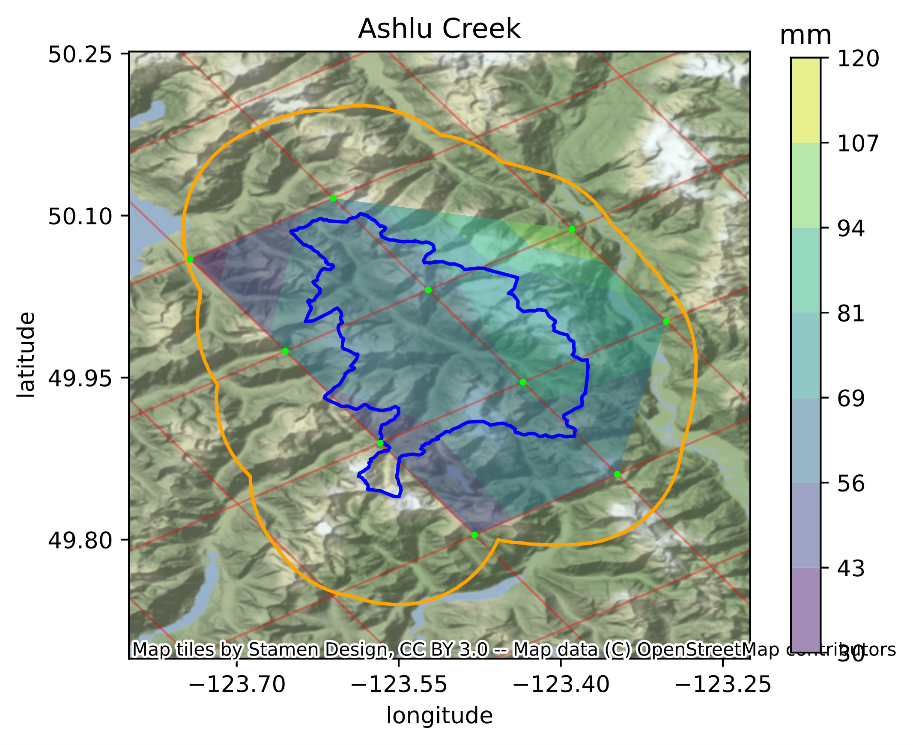

Slide 6
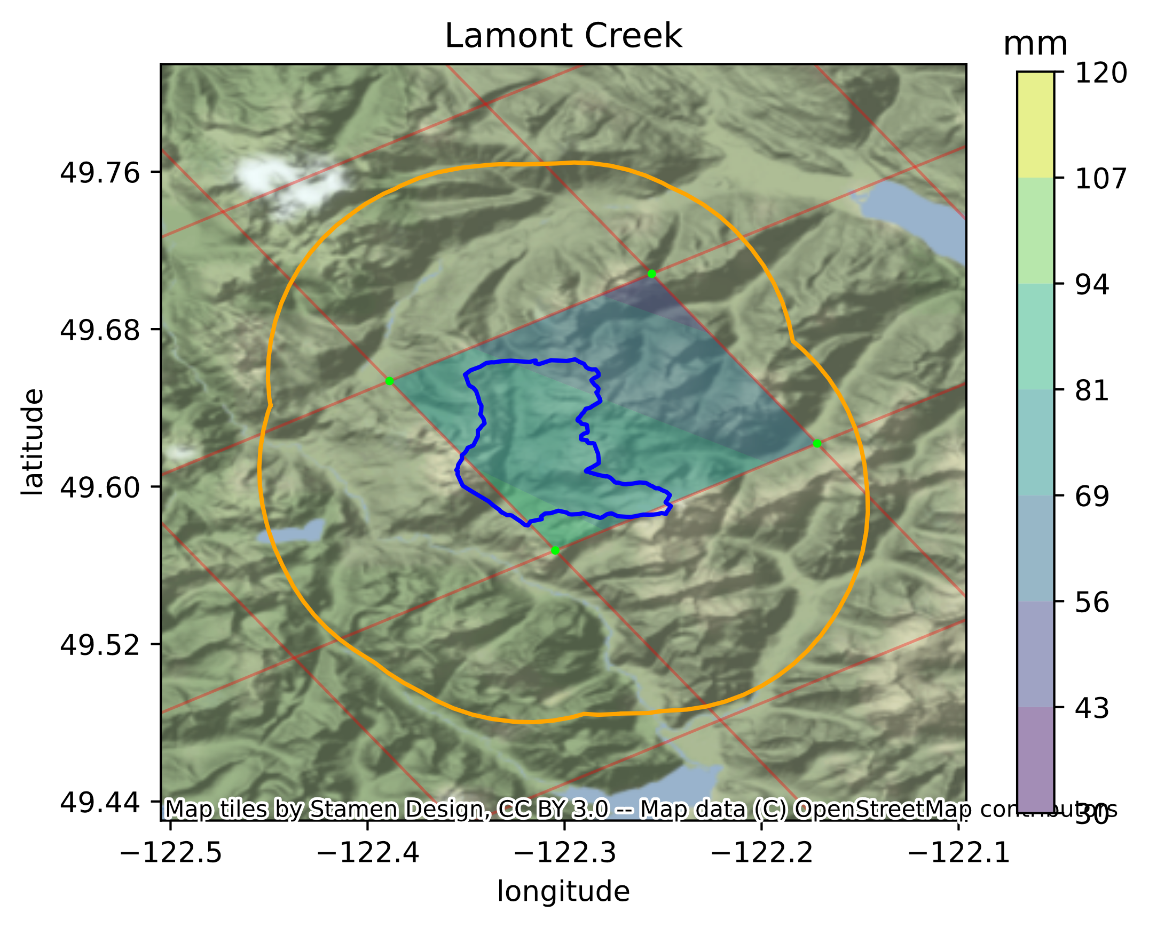
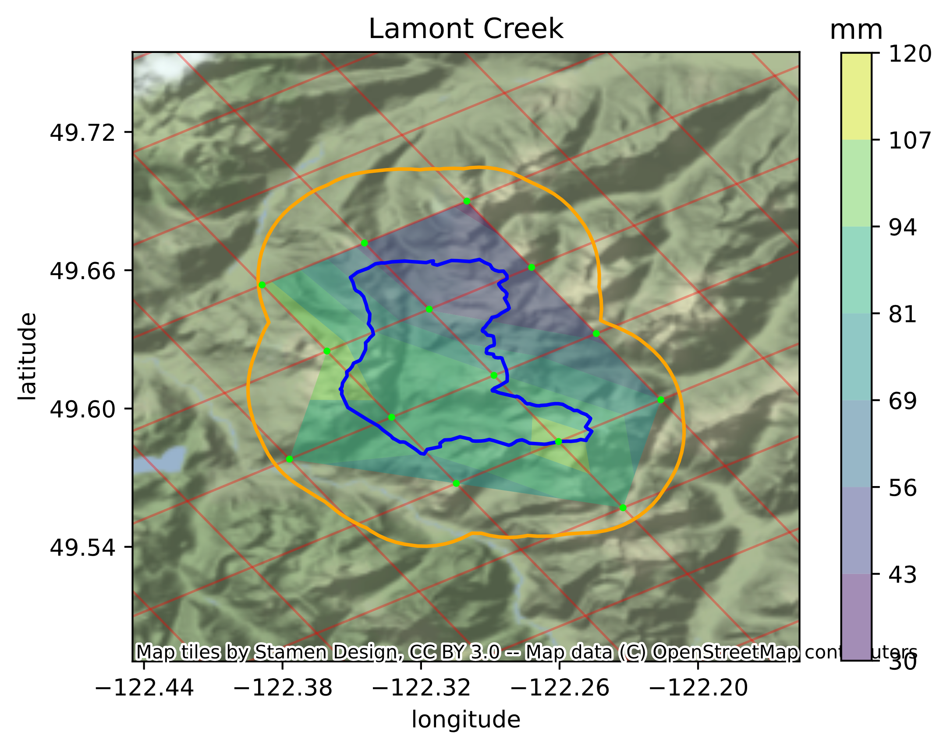

Slide 7
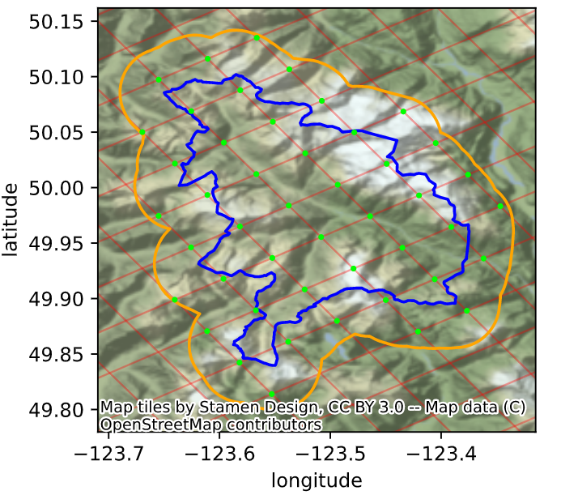

Slide 8
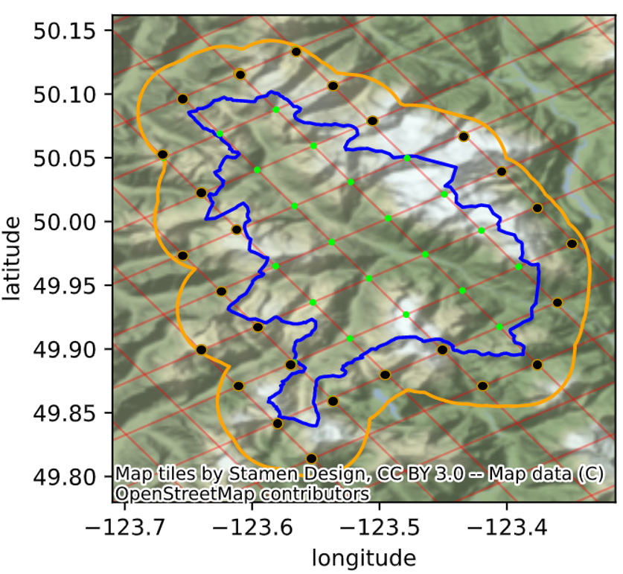
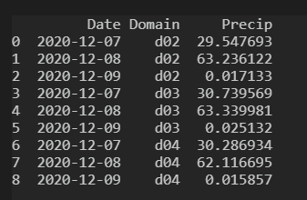

Slide 9
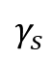
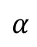
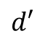
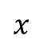
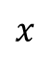
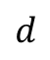


Top View
Side View
$$x$$
$$x$$
$$γ_{s}$$
$$d′$$
$$l$$
$$d$$
$$β$$
$$α$$

Slide 10
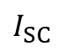
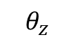
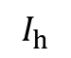
Zenith
$$I_{SC}$$
$$I_{h}$$
$$θ_{z}$$
Horizontal Surface

Slide 11
Initial observations (meteorological)
Weather model
Hydrological Model
Energy model
Initial observations (hydrological)
Precipitation (mmh⁻¹)
Decision-making model
Energy
(kWh)
Discharge
(m³s⁻¹)

Slide 12
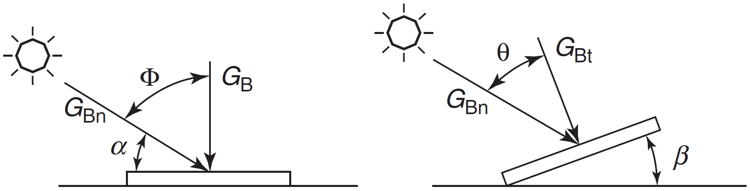
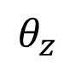
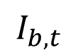

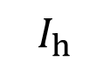
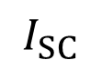
$$I_{b, t}$$
$$θ_{z}$$
$$I_{h}$$
$$I_{SC}$$
$$I_{SC}$$

